Slide 1
Software Testing
Lecture 2- Life cycles

Slide 2

Lesson objectives
Get to know:
Software Development model
Testing concepts
Testing Process
Test levels
Test types
Notes:
Mô tả nội dung mà học viên phải đạt được khi kết thúc môn học này

Slide 3
Review
1 A failure is: a) found in the software; the result of an error. b) departure from specified behavior c) an incorrect step, process or data definition in a computer program. d) a human action that produces an incorrect result.
2. During which test activity could faults be found most cost effectively? a. Execution b. Design c. Planning d. Check Exit criteria completion

Slide 4
Review
1. Which, in general, is the least required skill of a good tester? a. Being diplomatic b Able to write software c. Having good attention to detail d. Able to be relied on
2. How much testing is enough a. This question is impossible to answer b. The answer depends on the risks for your industry, contract and special requirements c. The answer depends on the maturity of your developers d. The answer should be standardized for the software development industry

Slide 5
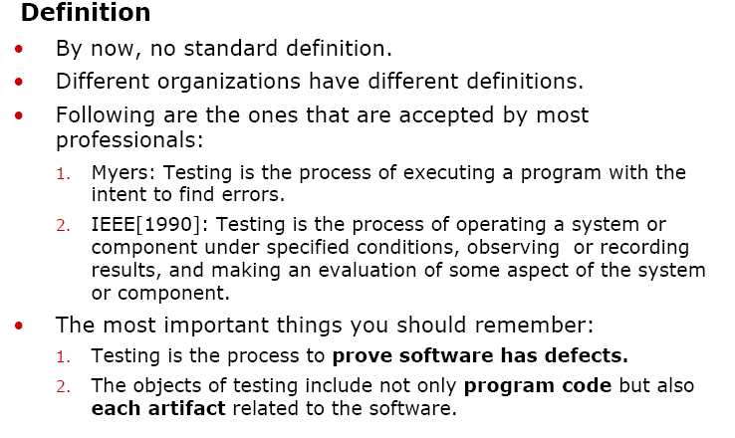
What is Software Testing

Slide 6
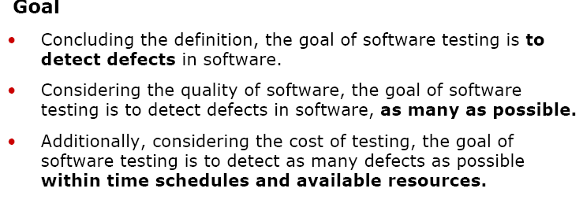
The Goal of Software Testing?

Slide 7
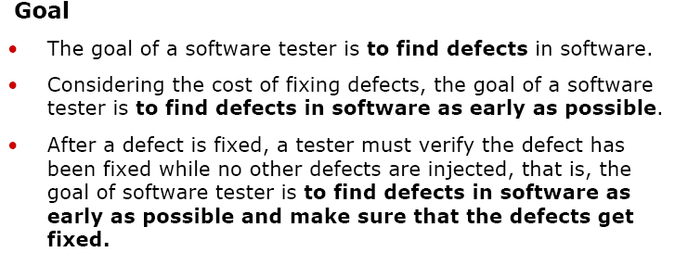
The Goal of Software Tester?

Slide 8
The Role of Testing
Role of testing in software development, maintenance and operations
Reduce the risk of problems
Reduce long-term defect-related costs
Contribute to the quality of the software
Help meeting standards:
Contractual or legal requirements
Industry-specific standards

Slide 9

Main Test Activities
Testing is not just running tests, but also:
Planning and control
Choosing test conditions
Designing and executing test cases
Checking results
Evaluating exit criteria
Reporting on the testing process and system under test
Finalizing or completing closure activities

Slide 10
How is Actual SW testing Carried out?
Ideal
System
Inputs
Compare
Result
Real
System

Slide 11
What Is Software Develop Process
Definition
The process by which users’ needs are translated into a software product, often including:
1. Requirement phase
2. Design phase
3. Code phase
4. Testing phase
5. Implementing phase
6. Maintenance
Common software development models
• Waterfall Model
• V-Model
• Spiral Model
• Rational Unified Process

Slide 12
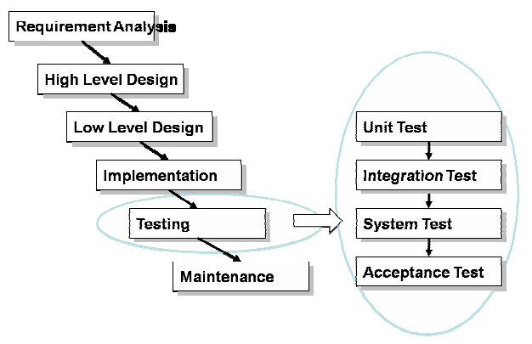
Waterfall Model

Slide 13
Software development model (cont.)
** Waterfall model (cont)
Strengths:
Easy to understand, easy to use
Provides structure to inexperienced staff
Milestones are well understood
Sets requirements stability
Good for management control (plan, staff, track)
Works well when quality is more important than cost or schedule

Slide 14
Software development model (cont.)
** Waterfall model (cont)
Deficiencies:
All requirements must be known upfront
Deliverables created for each phase are considered frozen – inhibits flexibility
Integration is one big bang at the end
Little opportunity for customer to preview the system (until it may be too late)

Slide 15
Software development model (cont.)
** Waterfall model (cont)
Deficiencies:
All requirements must be known upfront
Deliverables created for each phase are considered frozen – inhibits flexibility
Integration is one big bang at the end
Little opportunity for customer to preview the system (until it may be too late)

Slide 16
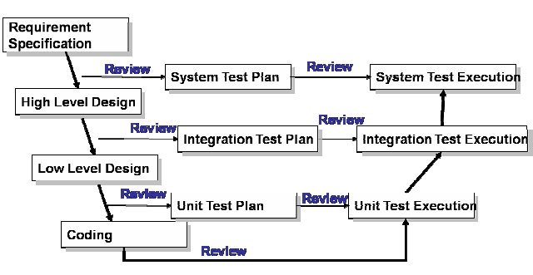
V-Model

Slide 17
Testing And V-Model
Testing and V-model
In a waterfall model, testing is the last phase of the software develop process, where in a V-model, testing is an activity that goes through the whole software development process.
Testers can be involved earlier.
1. Testers can be familiar with the products. This is good for them to design qualified test cases.
2. More defects will be found in the early phases. This will reduce the cost.
The risk of finding serious defects near the end of the development process is reduced.
V-model is the model that has been adopted by most organizations.

Slide 18
Software development model (cont.)
** V-shaped model (cont)
A variant of the Waterfall that emphasizes the verification and validation of the product.
Testing of the product is planned in parallel with a corresponding phase of development

Slide 19
Software development model (cont.)
** V-shaped model (cont)
- Strengths:
Emphasize planning for verification and validation of the product in early stages of product development
Each deliverable must be testable
Project management can track progress by milestones
Easy to use

Slide 20
Software development model (cont.)
** V-shaped model (cont)
Deficiencies:
Does not easily handle concurrent events
Does not handle iterations or phases
Does not easily handle dynamic changes in requirements
Does not contain risk analysis activities

Slide 21
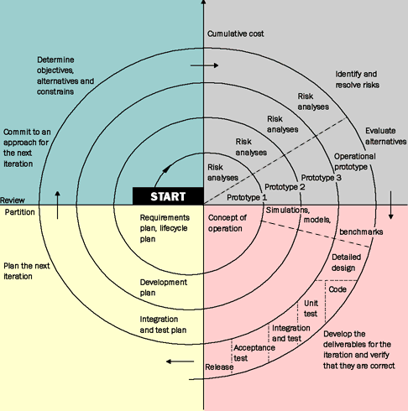
Spiral Model

Slide 22
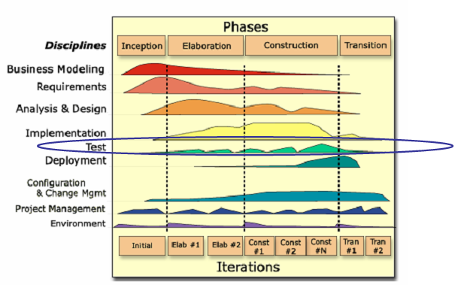
Rational Unified Process (RUP)

Slide 23
Software development model (cont.)
** Agile-Scrum model:
Be a lightweight process framework for agile development
Be the most widely-used one
Be most often used to manage complex software and product development, using iterative and incremental practices
Increase productivity and reduces time to benefits relative to classic “waterfall” processes.

Slide 24
Software development model (cont.)
** Agile-Scrum model (cont):
Enable organizations to adjust smoothly to rapidly-changing requirements, and produce a product that meets evolving business goals

Slide 25
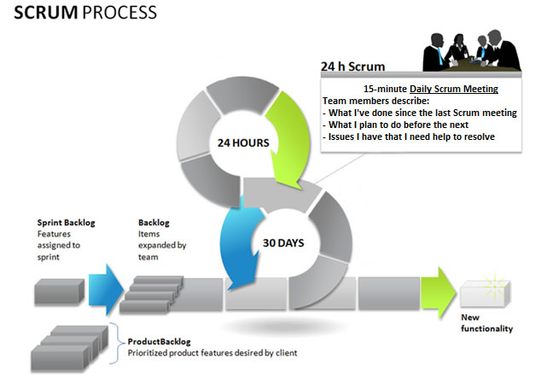
Software development model (cont.)
** Agile-Scrum model (cont):

Slide 26
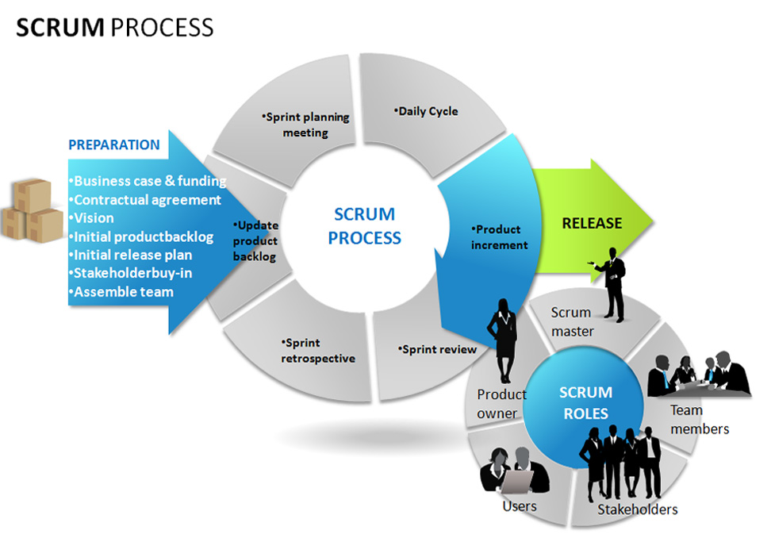
Software development model (cont.)
** Agile-Scrum model (cont):

Slide 27

Scrum framework
People
Product owner
ScrumMaster
Team
Meeting
Sprint planning
Sprint review
Sprint retrospective
Daily scrum meeting
Tools
Product backlog
Sprint backlog
Burndown charts

Slide 28
Software development model (cont.)
** Agile-Scrum model (cont):
Scrum Master: The keeper of process who is responsible for making the process run smoothly, for removing obstacles that impact productivity, and for organizing and facilitating the critical meetings
Product Owner: The keeper of the requirements who provides “the single source of truth” for the team regarding to requirements and their planned order of implementation

Slide 29
Software development model (cont.)
** Agile-Scrum model (cont):
Team: A self-organizing and cross-functional group of people who do the hands-on work of developing and testing the product; is responsible for producing product
Users
Stakeholders

Slide 30
Example of product backlog
Backlog item | Estimate
Allow a guest to make a reservation | 3
As a guest, I want to cancel a reservation. | 5
As a guest, I want to change the dates of a reservation. | 3
As a hotel employee, I can run RevPAR reports (revenue-per-available-room) | 8
Improve exception handling | 8
... | 30
... | 50

Slide 31

Tasks
Mon
Tues
Wed
Thur
Fri
Code the user interface
8
4
8
Code the middle tier
16
12
10
7
Test the middle tier
8
16
16
11
8
Write online help
12
50
40
30
Hours
20
10
0
Mon
Tue
Wed
Thu
Fri

Slide 32
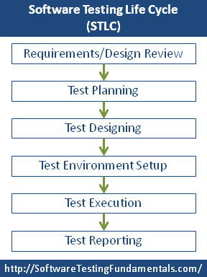

Slide 33
Process of Software Testing

Slide 34
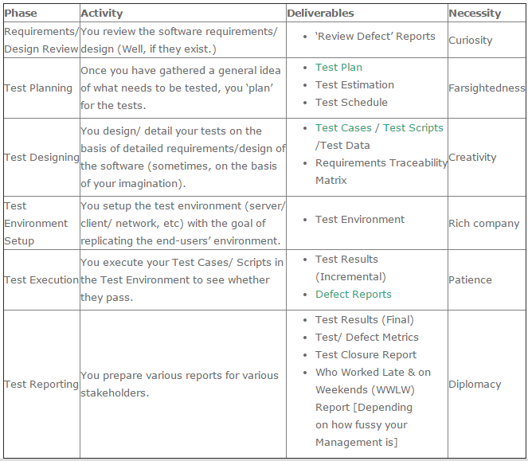

Slide 35
TESTING CONCEPTS
Agenda:
- Manual testing vs. Automation testing
- Test objective
- Test design
- Test requirement
- Test case, test script
- Test report
- Bug report
- Test plan

Slide 36
TESTING CONCEPTS
Agenda (cont):
- Test level
- Test type
- Test technique
- Traceability matrix
- Bug tracking system (JIRA)
- Test Link
- Web-based application testing

Slide 37
TESTING CONCEPTS
Manual testing vs. Automation testing?
Manual testing | Automation testing
- Executing test cases w/o any support tools | - Executing test cases w/ supported tools
- Be useful at the beginning of project | - Be useful when the application is stable
- Be used when the test case only needs to run once or twice | - Be used when there is need to execute the set of test cases repeatedly
- Be slow | - Be faster than manual testing
- Require less cost | - Initial cost to automate is more than manual testing

Slide 38
TESTING CONCEPTS
Manual testing vs. Automation testing? (cont)
Manual testing | Automation testing
- Be preferable to execute UI test cases using manual testing | - Be not preferable to execute UI test cases using automation testing

Slide 39
A Test Plan
A test plan is a general document describing the general test
philosophy and procedure of testing. It will include:
Test environments
Description of test phases and functionality tested in each
List of test cases to be executed
Test success/failure criteria of the test phase
Hardware/software dependencies
Personnel
Regression activities

Slide 40
TESTING CONCEPTS
2. Test requirement: WHAT
Identify:
+ What needs to be tested
+ What are you going to validate them
Cover:
+ Business rules
+ Functionalities
+ Non-functional standards

Slide 41
TESTING CONCEPTS
2. Test requirement: (cont)
Example: ATM testing:
Business requirements:
+ ATM must do withdrawals
+ Withdrawals are between 50K VND-15M VND
+ Withdrawals are in 50K multiples

Slide 42
TESTING CONCEPTS
2. Test requirement: (cont)
Example: ATM testing:
Test requirements:
+ Verify that a withdrawal option is available
+ Verify that a withdrawal of a multiple of 50K, between 50K-15M can be done
+ Verify that <50K is not allowed
+ Verify that >15M is not allowed
+ Verify that non-50K multiples between 50K-15Mnot allowed

Slide 43
TESTING CONCEPTS
2. Test requirement: (cont)
Example: ATM testing:
Test requirements:
+ Verify that strange numeric amounts/combinations are not allowed
+ Verify that the withdrawal received is equal to the amount requested
+ Verify that a valid withdrawal amount must be below the account balance

Slide 44
TESTING CONCEPTS
2. Test requirement: (cont)
Exercise:
Create new Gmail account:
Business requirement:
User account cannot be duplicate
Username must be more than 4 characters and does not have specific characters
Password must have at least 8 characters including letters, number and specific characters

Slide 45
TESTING CONCEPTS
2. Test requirement: (cont)
Exercise:
b. Edit Gmail user profile
Business requirement: Beside the business same as above, it shall:
Username cannot be blank
Password cannot be blank
User’s age have to be at least 14 (calculated by year)

Slide 46
Test Cases and Test Data
Test cases : Inputs to test the system, combined with execution conditions and the expected results from these inputs that demonstrate whether the system operates according to its specification
Test data : Inputs which have been devised to test the system

Slide 47
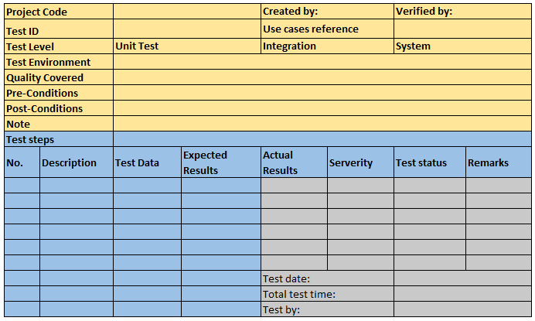

Slide 48
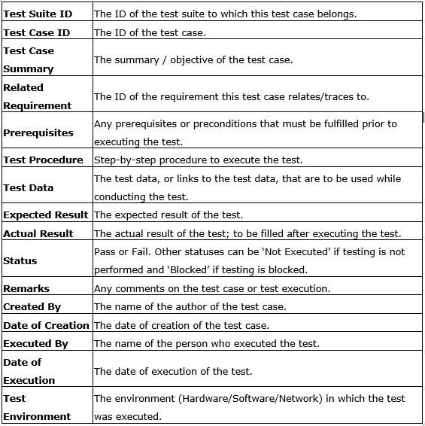

Slide 49
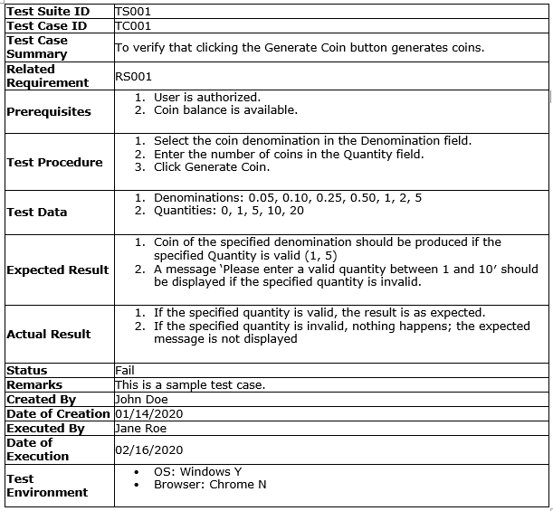

Slide 50
Example Test cases for ATM
Positive Test Cases
Machine accepts card and PIN detail.
Machine successfully takes out the money.
Machine takes out the balance printout after the withdrawal.
Machine logs out of the client session immediately after withdrawal successfully.
Machine prints out balance inquiry standalone as part of menu operation.
Machine generates invalid money error due to money asked larger than the savings account balance.
Machine checks for the idle time in between the client session and wait period while active in account.
Machine accepts both Visa and Mastercard credit and debit cards.

Slide 51
Example Test cases for ATM
Negative Test Cases
Machine does not accept card and PIN.
Machine finds wrong PIN.
Machine finds card insertion in wrong way.
Machine takes 3 invalid PIN attempt.
Invalid account type selected in the menu.
Lack of money in the savings account.
Expired card inserted in the machine.
Money amount less than 100 entered in the machine.
Machine does not take out the money.
Machine can’t take out the balance after withdrawal.
Machine can’t log out of client session after withdrawal.
Machine doesn’t print the withdrawal amount.
Machine does not accept either Visa or mastercard or both debit/credit cards.

Slide 52
TESTING CONCEPTS
4. Test Report:
Provide test result in an organized manner, describes the environmental or operating conditions, and shows the comparison of test results with test objectives.
Daily status report:
+ What done today
+ Plan for the next working day
+ Questions and Issues
+ Requests

Slide 53
TESTING CONCEPTS
4. Test Report: (cont)
Example: Please refer to Daily Status Report_Temp.docx

Slide 54
TESTING CONCEPTS
5. Bug report:
What is a bug: An error, failure, or fault in a computer program or system that causes it to produce an incorrect or unexpected result, or to behave in unintended ways
Bug report:
+ Summary
+ Priority
+ Severity
+ Description
+ Steps to reproduce

Slide 55
TESTING CONCEPTS
5. Bug report:
Bug report: (cont)
+ Actual result
+ Expected result
+ …

Slide 56
TESTING CONCEPTS
6. Test level:
USER ACCEPTANCE TEST
SYSTEMTEST
INTEGRATION TEST
UNIT TEST

Slide 57
TESTING CONCEPTS
6. Test level (cont):
Unit test: a level of the software testing process where individual units/components of a software/system are tested
Purpose: to validate that each unit of the software performs as designed.
Integration test: a level of the software testing process where individual units are combined and tested as a group.
→ Purpose: to expose faults in the interaction between integrated units.

Slide 58
TESTING CONCEPTS
6. Test level:
System test: a level of the software testing process where a complete, integrated system/software is tested.
→ Purpose: to evaluate the system’s compliance with the specified requirements.
User acceptance test: a level of the software testing process where a system is tested for acceptability
→ Purpose: to evaluate the system’s compliance with the business requirements and assess whether it is acceptable for delivery

Slide 59
TESTING CONCEPTS
7. Test type:
Ad hoc testing: Testing without any test cases or documentation. The person performing ad-hoc testing has a good understanding of software requirements.
Acceptance testing: Performed by end customer to check if software confirms to their business needs and to the requirements provided earlier.
Black box testing: Testers do not need to know the code or internal structure of the software

Slide 60
TESTING CONCEPTS
7. Test type (cont):
White box testing (Glass box testing, Structural testing): Testers need to know the internal working of the software.
Grey box testing (Gray box testing): The combination of black box and white box testing
Exploratory testing: A type of testing conducted to learn the software at the same time looking for errors.

Slide 61
TESTING CONCEPTS
7. Test type (cont):
Retesting: A type of testing that is carried out as a part of defect fix verification
Regression testing: A type of testing that is carried out to find defects that got introduced to defect fixes or introduction of new feature(s)
Smoke testing: To check if new build (version) provided by development team is stable enough

Slide 62
TESTING CONCEPTS
7. Test type (cont):
Performance testing:
+ Load testing: To check the behavior of software under normal and over peak load conditions
+ Stress testing: To check how the software behave at breakpoint
+ Volume testing: To find the response of the software with the different sizes of data being received or to be processed by software

Slide 63
TESTING CONCEPTS
7. Test type (cont):
Security testing: To secure the software
Usability testing: To understand how user friendly the software is

